Slide 1
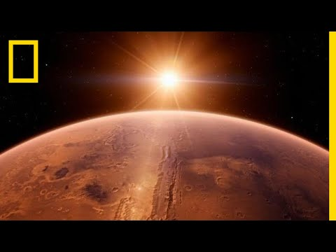
WATCH
What problems would we face if we wanted to inhabit Mars?
Jot down your thoughts here:

Slide 2
“We will in the coming decades establish ourselves in orbit around the Moon, on the surface of Mars, and in a more distant future on moons of Jupiter and Saturn. To get there we must learn how to sustain human life in hostile environments, with limited resupply. What balance of mechanical and biological systems will be required to sustain human life in a growing, off-world habitat?”

Slide 3
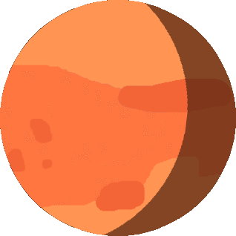
EQ: How can I use the SIMOC model to develop a habitat to support life off-world?
The SIMOC model uses authentic data gathered from decades of NASA and other science research on life support systems to develop a habitat to support at least 4 researchers on Mars or other off-world environments. This is your chance to be a citizen scientist! The results from your simulations will become a part of the data used to help research and solve this problem!

Slide 4
You will design a Mars habitat complete with astronauts, crew quarters, greenhouse, plants, solar panels and batteries. You will set their model in motion, simulating weeks, months, even a year living on Mars in total isolation to learn if the balance of food, power, machines and plants enables a successful, sustainable mission.
SIMOC is a scalable, interactive model of an off-world community built upon life support and closed ecosystem research at NASA, Paragon, and universities world-wide. The goal is to design the minimum complexity required to sustain human life on another world with a combination of mechanical life support (as on the International Space Station) and bioregeneration (living plants). You will gain an appreciation for the challenges of living on another planet, and a deeper understanding of the impact of our choices here on Earth.

Slide 6
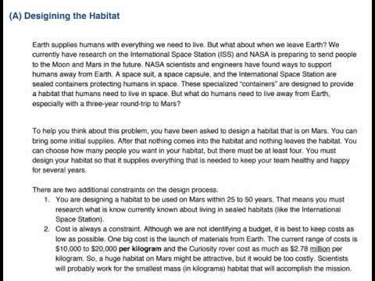
WATCH
What happens on Mars stays on Mars!
What constraints do you need to consider when designing your habitat?
Jot down your thoughts here:

Slide 7
Based on your brainstorming, you’ve identified these basic human needs on Mars:
Breathable air
Drinkable water
Food
Waste disposal
Energy
Protection
Some questions you still need to think about are:
How will we provide breathable air?
How will we provide clean water?
How will we get food?
How will we dispose of waste?
How will we get energy and power our systems?
How will we protect ourselves from the harsh environment?

Slide 8
Designing a research station on Mars breaks down
into 2 major components
How do you design a habitat that will provide life support for the researchers?
How do you design an environment that promotes health and emotional support in an alien environment?
and

Slide 9
Research-Type your answers in the text boxes.
Helpful Websites:
https://marsed.asu.edu/marsepedia
https://mars.nasa.gov/all-about-mars/facts/#?c=inspace&s=distance
HERA- Human Exploration Research Analog: https://www.nasa.gov/analogs/hera University of Arizona Controlled Environment Agriculture Center Prototype Lunar Greenhouse: https://cals.arizona.edu/lunargreenhouse/ 1991-1993: Biosphere II’s Grand Experiement: https://tucson.com/biosphere-ii-s-grandexperiment/article_24dfae02-c6ac-11e5-b16a-2323b66e110b.html
How Living Inside Biosphere 2 Changed These Scientists’ Lives: http://mentalfloss.com/article/81553/how-living-inside-biosphere-2-changed-these-scientists-lives
The World’s Largest Earth Science Experiment: Biosphere 2: https://www.ecowatch.com/the-worldslargest-earth-science-experiment-biosphere-2-1882107636.html
International Space Station Hadfield Videos:
https://blogs.scientificamerican.com/psi-vid/top-10- commander-chris-hadfield-videos-from-the-iss/ https://www.spacestationexplorers.org/news-media/videos/
What are the temperatures like on Mars?
What is the terrain like?
What kind of atmosphere is there on Mars?
Is there water and food on Mars?
Earth’s atmosphere includes nitrogen (78%), Oxygen (21%), Argon (0.93%), Carbon Dioxide (0.04%), and trace amounts of neon, helium, methan, krypton, hydrogen, and water vapor. How do we maintain this composition of air on Earth?
Could we use some of the same techniques in a closed habitat on Mars?
What designs has NASA worked on that could guide us?
How much water does a person need every day?
How does Earth produce clean water and recycle impure water?
Can this be done in a closed habitat on Mars?
What systems has NASA designed to provide clean water in a closed habitat?

Slide 10
Design A Prototype- Create a design for your Mars habitat. You will be testing it out in the SIMOC simulator. The data from your tests will help scientists design sustainable habitats!
From your research, consider these questions to help you describe your habitat:
Which sub-systems seem to work most reliably?
How they can work together to create the habitat?
Describe how you would design a habitat on Mars to sustain life for 4 humans. Provide a sketch with labels to help us visualize. Remember, you need a plan to provide drinkable water, breathable air, food, power, etc. All the while, you are keeping cost in mind.
Sketch (or insert pic of 3D design you’ve created):

Slide 11
Test Your Design - Go to https://dev.simoc.space/ and follow the directions to run a simulation to test your design (instructions on how to login are on the next slide). You will get quantitative results of testing your habitat design. Record the results below. You can adjust factors as you go to help you be more successful. Remember: Your design/simulations provide scientists with useful information! You are a CITIZEN SCIENTIST! YOU MATTER!
SIMOC Simulation # | What were the starting conditions? | What worked well? | What did not work? | What would you change?

Slide 12
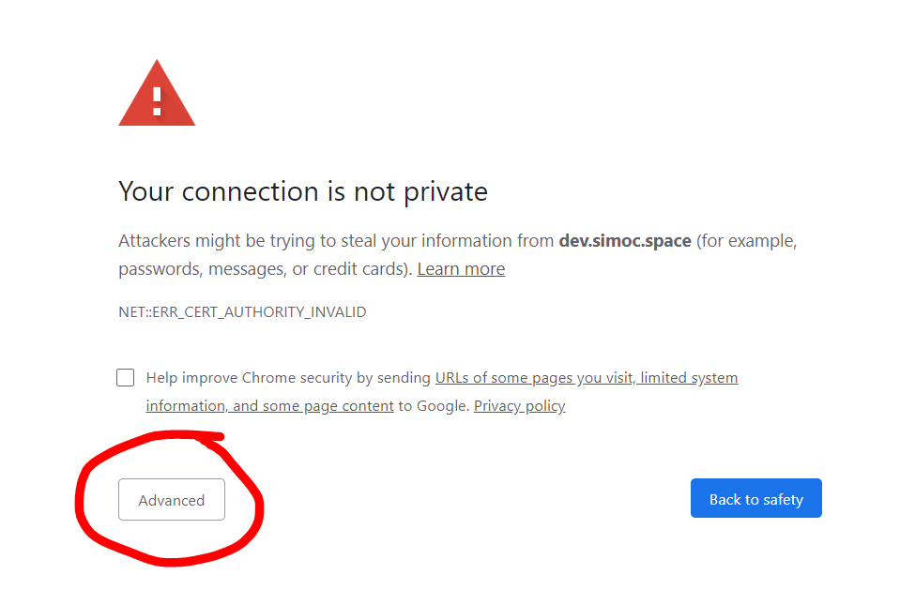
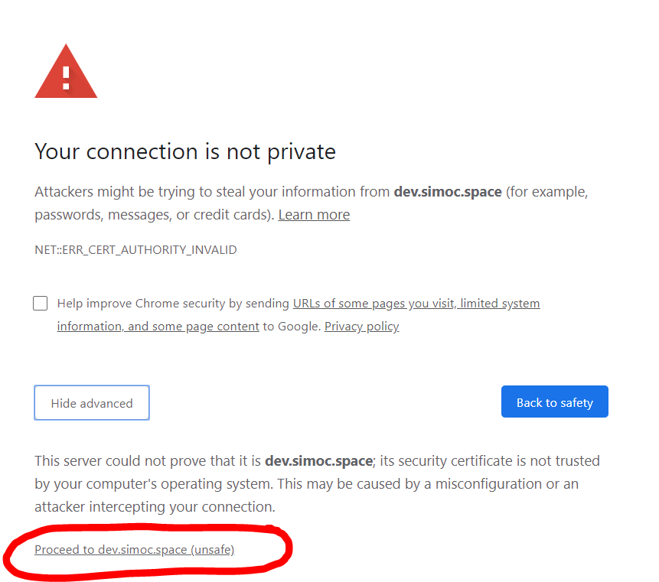
How to Access the Simulator:
Go to https://dev.simoc.space/
You will likely hit a security error screen. This is OK. You will need to click “Advanced”, and then “Proceed to dem/simoc/space (unsafe)”. It is safe, don’t worry.
Username: jimmykimmel Password: tomatoe
Once you are in, click Proceed.
Click “Sign Up” and create a username and password for yourself. Write it down just in case you forget it!
Click “New Configuration”. The other option requires you to have completed the simulation already and have downloaded data. You are welcome to do that, but you aren’t required to.
For this particular assignment, under “Presets” choose 4 humans for 10 days. Everything else can be based on your design. You can change it as needed each time you test your revised design!
Play around with the simulator! Have fun with it!

Slide 13
Reflect-Type your answers below and then go to Flipgrid and record a summary of your responses/reflection on this experience.
What did you learn based on your design and your test simulations?
How does this type of activity help society?
What ideas or questions did this activity help you generate?
Based on what you learned, what are some adaptations that would help organisms (plants and animals) survive on Mars?
Did you enjoy this activity? Why or why not?

