Slide 1
Login and/or Register

Slide 2
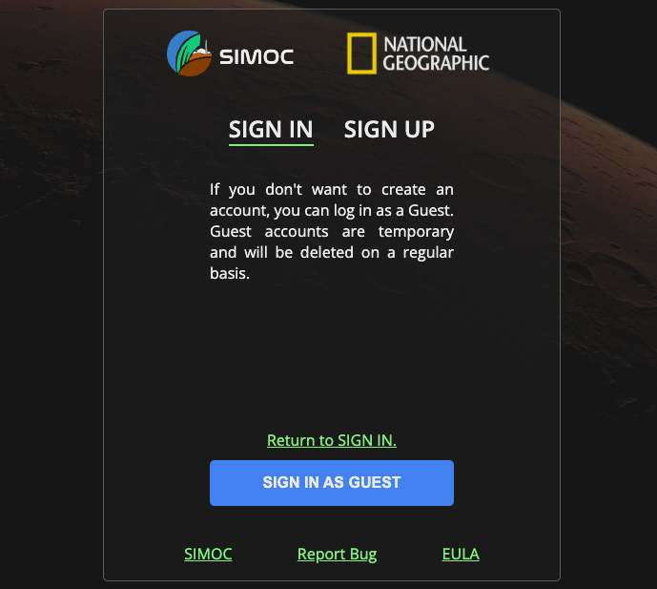
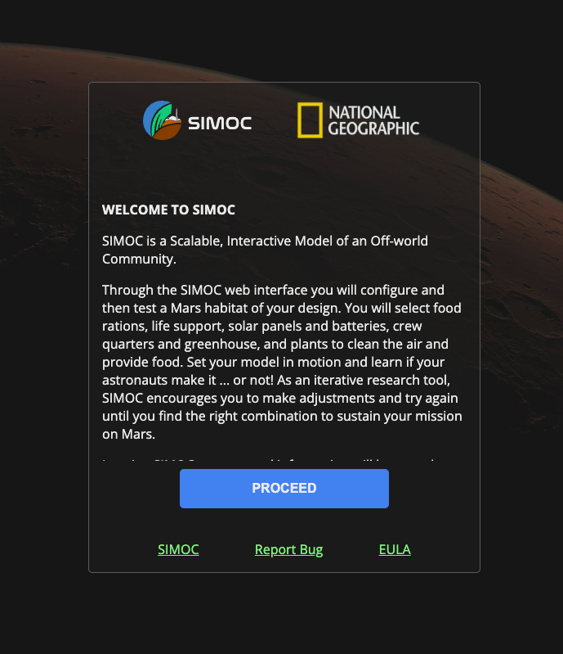
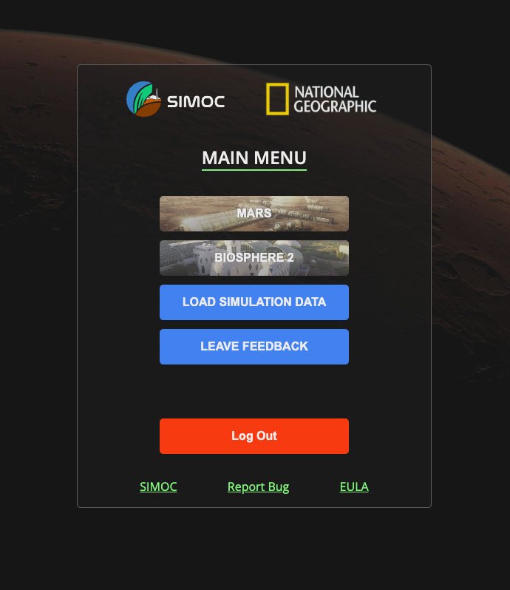
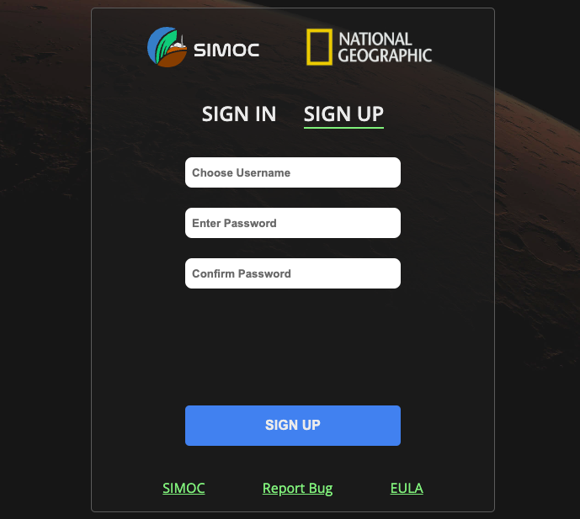
Login
Either login as a guest…
Navigate to ngs.simoc.space in a web browser.
Or go to the ‘Sign Up’ tab to register, and use your credentials to sign in.
Click ‘Proceed’
This will take you to the Main Menu.

Slide 3
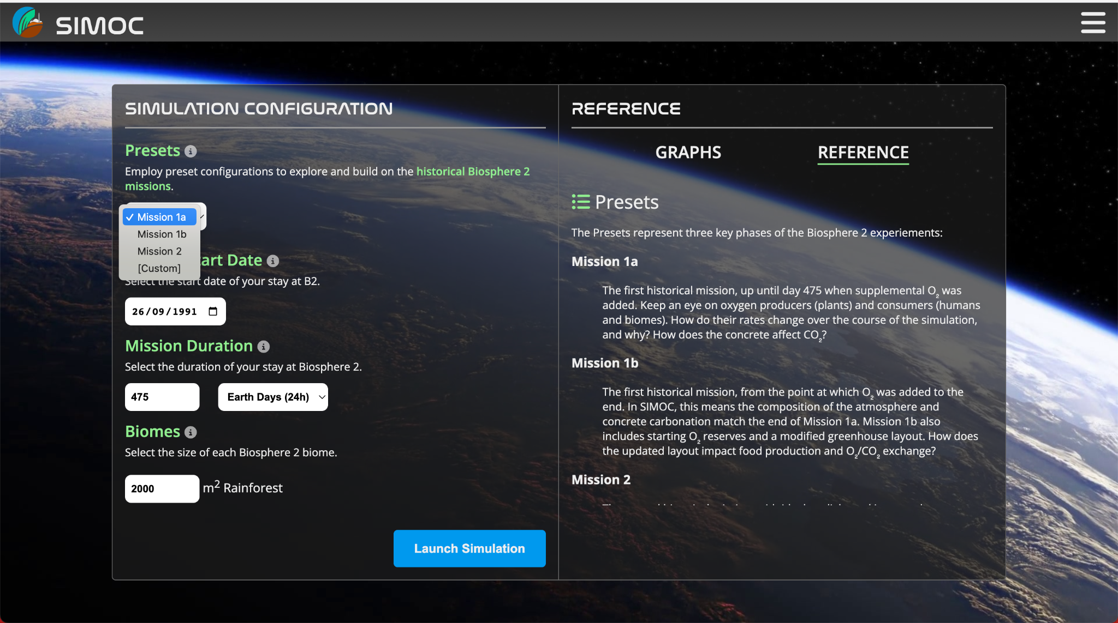
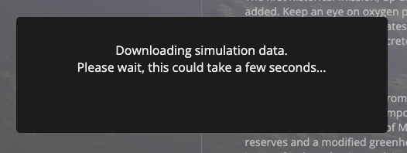
2. Configuration Screen
From the Main Menu, click on Biosphere 2 to proceed to the Configuration Screen.
Click on section headers to pull-up the Reference Panel for that section.
On the first time, select ‘Mission 1a’ preset (don’t make any other changes!), and then click Launch Simulation. This will take you to the Dashboard Screen.
Wait while the pre-calculated simdata is downloaded to your device. This could take several seconds.

Slide 4
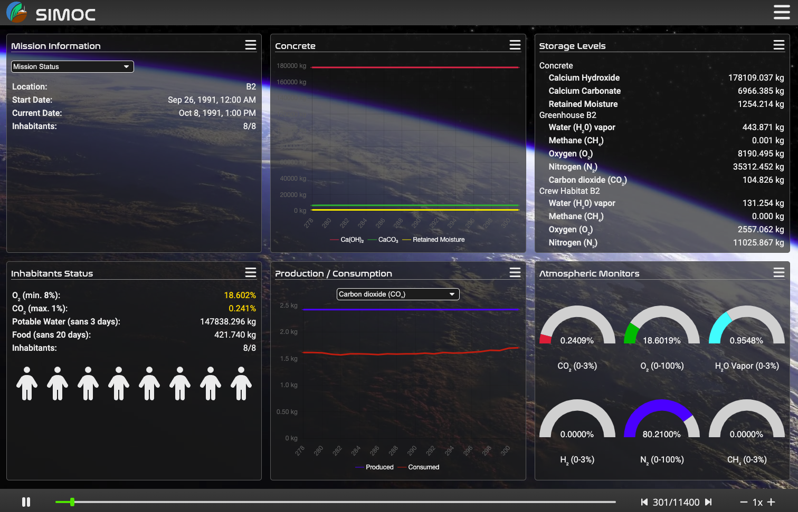
3. Dashboard Screen
On the first time, monitor the O₂ and CO₂ levels (to left or right) throughout the simulation.
Use the slider, buttons or arrow keys on your key board to move forward and backward in time.

Slide 5
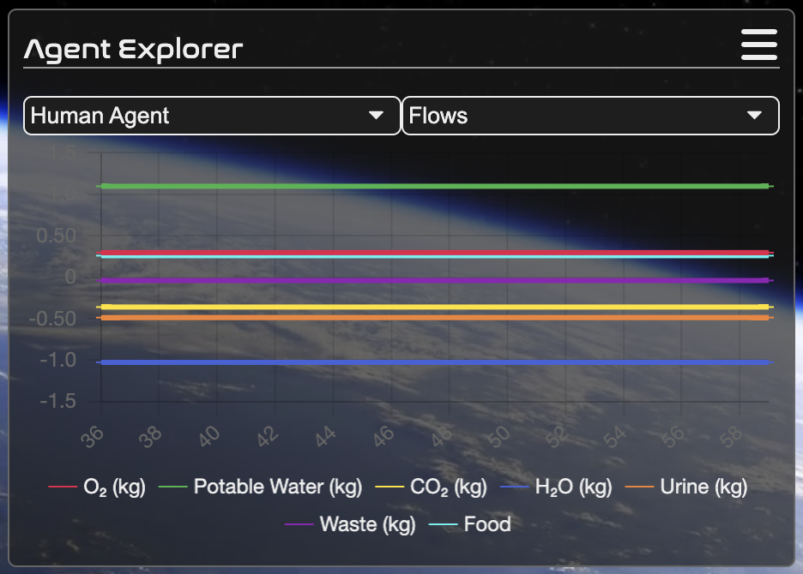
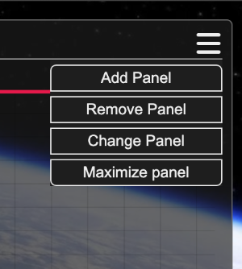
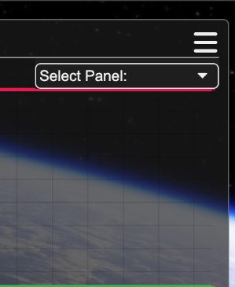
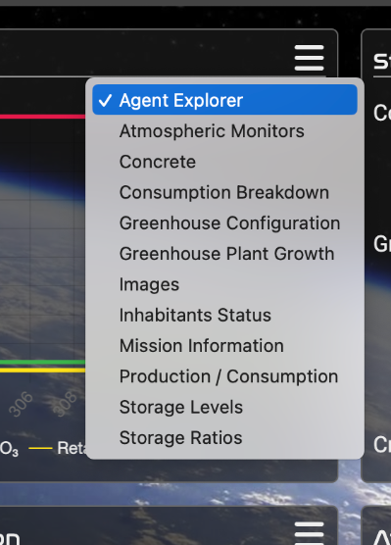
4. Agent Explorer
From any panel on the Dashboard Screen, click the menu icon and select ‘Change Panel’. Then select ‘Agent Explorer’ from the drop-down menu.
From this panel, you can select which Agent to display (left), and which field to plot for the current agent (right).
Add or remove items from the plot by clicking them on the legend.

Slide 6
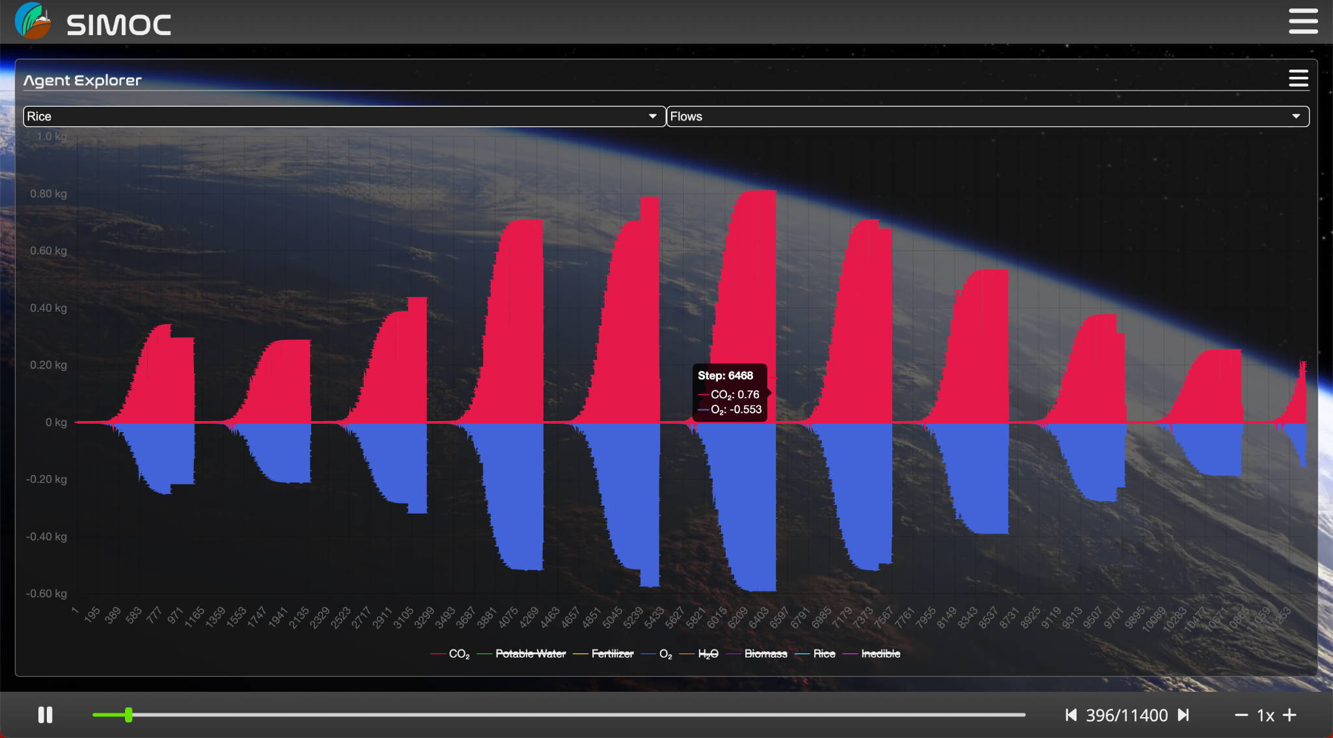
5. Fullscreen
From any panel on the Dashboard Screen, click the menu icon and select ‘Maximize Panel’.
This will display the entire simulation, or as much as has been loaded (for custom simulations). For long simulations like Biosphere 2, it may take several seconds to load and react to changes, depending on your machine.

Slide 7
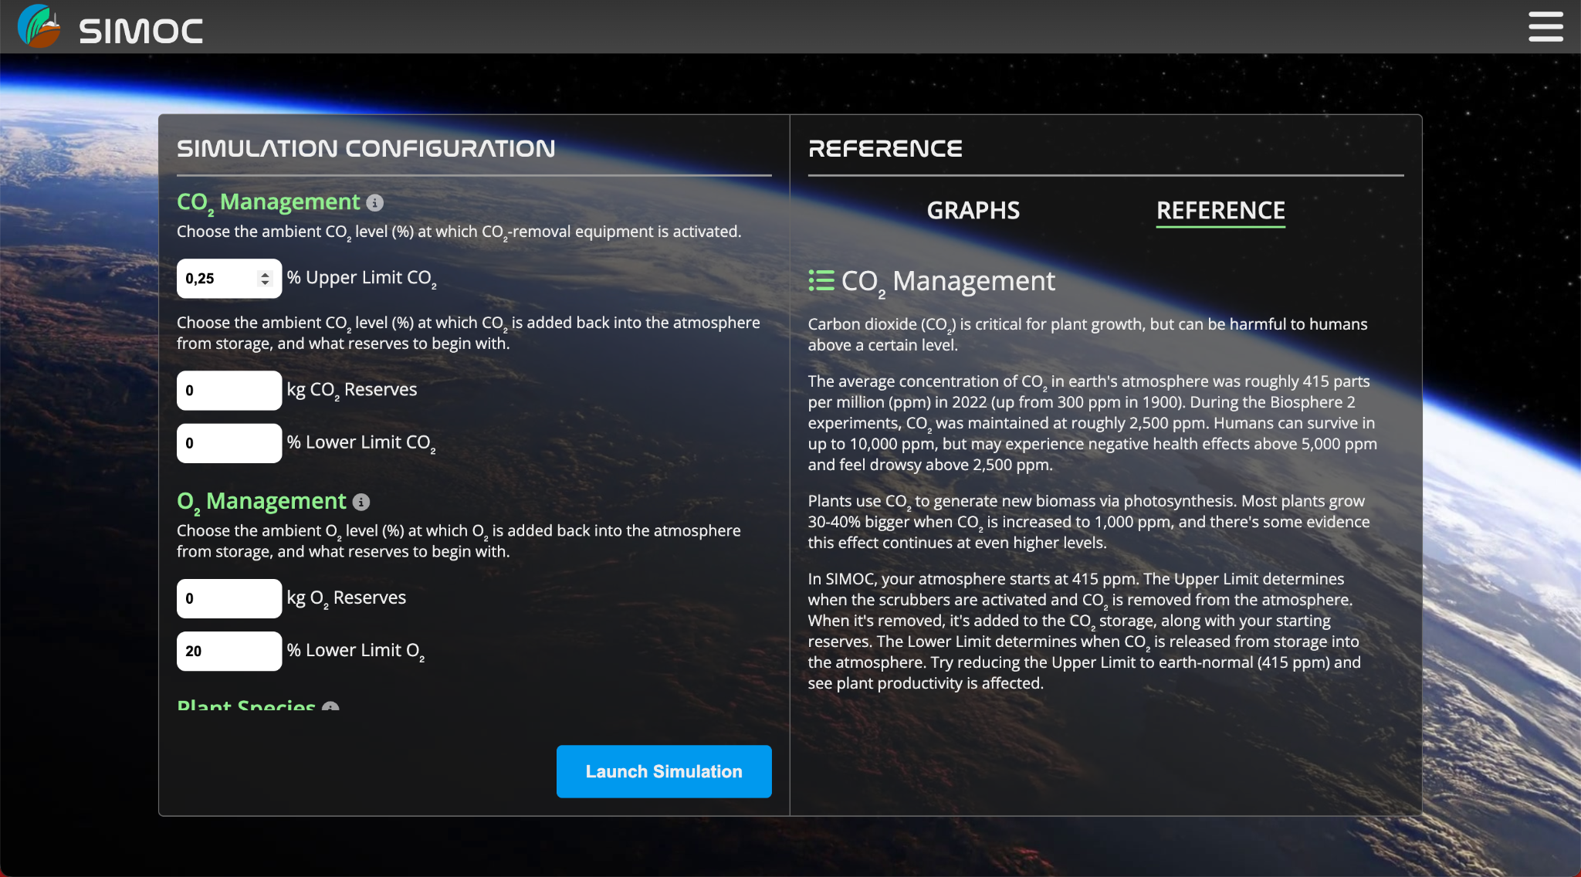
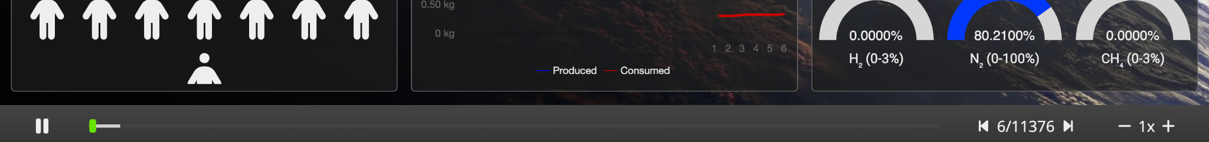
6. Custom Simulations
Scroll through the different sections, read the reference material, and make any desired changes.
After exploring Mission 1a, go back to the Configuration Screen by navigating ‘back’ in your browser.
When you’re ready, click ‘Launch Simulation’. For custom simulations, you will be taken directly to the Dashbaord (no loading message), and data will be sent to you from our severs as it is calculated.
The slider bar at the bottom of the Dashboard Screen indicates how many steps have been calculated, and how many are remaining. Depending the simulation, this can take up to 5 minutes to complete.

